Slide 1
Street Dance
Final performance and evaluation

Slide 2
Learning objectives
To engage in the final rehearsal process
To perform in front of an audience which includes members from outside of the class
To be able to complete and evaluation sheet, reflecting on your assessment.

Slide 3
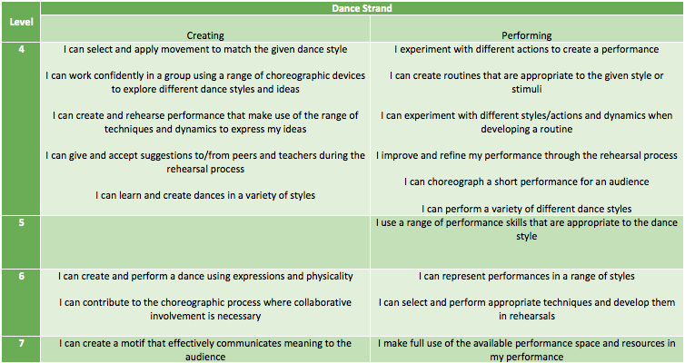
Success Criteria

Slide 4
How you can achieve what you want
Good:
You must have filled in your log sheets
You must have joined in all rehearsals, having behaved safely and concentrated on the routine
You must know the dance and perform it to an audience

Slide 5
How you can achieve what you want
Better:
You must have filled in your log sheets in detail, setting appropriate and thoughtful targets, identifying areas of strength and where to improve
You must have taken an active role in all rehearsals, being focused, striving to improve and considering performance skills
You must know the dance well and perform it to an audience with confidence and style.

Slide 6
How you can achieve what you want
Amazing:
You must have filled in your log sheets using words learned in each session, and have tried to achieve the targets you set each week with some success,
You must have taken a lead learner role in all rehearsals, showing consideration of performance skills and always trying your best
You must know the dance perfectly and perform it to an audience with confidence, a street dance style and interpretive skills.

Slide 7
Full group rehearsal Small group rehearsal and peer assessment Small group rehearsal to improve Final performance and filming

Slide 8
Key words to use…
Final rehearsal, polishing, confidence, street style, style, group work, audience, strength, area for development, rehearsal
use of space, performing movements accurately, timing (rhythm), focus, balance, coordination, flexibility stamina
Extension, projection, spatial awareness, stylistic detail,

Slide 9
Watch the performances back
Say 3 positive things about your groups performance
Name one thing you want to improve on for next time.

Slide 10
Plenary
Have you been able to perform in front of an audience?
Did you use your final rehearsal time well?
What sort of things did you put on your evaluation sheet?
How have you found this term?
What have you enjoyed?
How have you progressed?
What do you need to do to progress further?

